Slide 1

Object Oriented Programming (OOP) Course Code: CSE2005/SWE2005
MODULE – 5
(Concurrent Programming)
By:
Dr. Nagendra Panini Challa
Assistant Professor, Senior Grade 2
SCOPE, VIT-AP University, India

Slide 2
Agenda
Multi-Threaded Programming
Process Vs Thread
Thread Life Cycle
Thread class
Runnable interface
Thread Creation
Interrupting Threads
Thread States
Thread Properties
Thread Control and Priorities
Inter Thread Communication
Thread Synchronization
Synchronization.

Slide 3
Multithreading in Java
Multithreading in Java is a process of executing multiple threads simultaneously.
A thread is a lightweight sub-process, the smallest unit of processing. Multiprocessing and multithreading, both are used to achieve multitasking.
We use multithreading than multiprocessing because threads use a shared memory area. They don’t allocate separate memory area so saves memory, and context-switching between the threads takes less time than process.
Java Multithreading is mostly used in games, animation, etc.

Slide 4
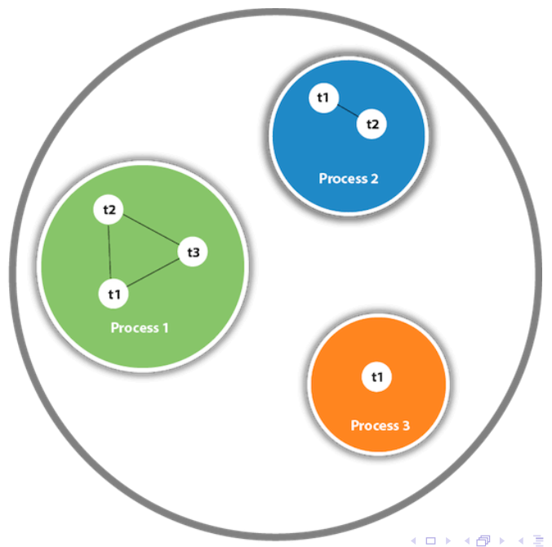

Slide 5
Advantages
It doesn’t block the user because threads are independent and you can perform multiple operations at the same time.
You can perform many operations together, so it saves time.
Threads are independent, so it doesn’t affect other threads if an exception occurs in a single thread.
Multitasking: Multitasking is a process of executing multiple tasks simultaneously. We use multitasking to utilize the CPU. Multitasking can be achieved in two ways:
Process-based Multitasking (Multiprocessing)
Thread-based Multitasking (Multithreading)

Slide 6
Process-based Multitasking and Thread-based Multitasking
Process-based Multitasking
Each process has an address in memory. In other words, each process allocates a separate memory area.
A process is heavyweight.
Cost of communication between the process is high.
Switching from one process to another requires some time for saving and loading registers, memory maps,
updating lists, etc.
Thread-based Multitasking
Threads share the same address space.
A thread is lightweight.
Cost of communication between the thread is low.

Slide 7
What is Thread in java
A thread is a lightweight subprocess, the smallest unit of processing. It is a separate path of execution.
Threads are independent. If there occurs exception in one thread, it doesn’t affect other threads. It uses a shared memory area.
A thread is executed inside the process. There is context-switching between the threads. There can be multiple processes inside the OS and one process can have multiple threads.
Note: At a time one thread is executed only.

Slide 8
Java Thread class
Java provides Thread class to achieve thread programming.
Thread class provides constructors and methods to create and perform operations on a thread.
Thread class extends Object class and implements Runnable interface.

Slide 9
Java Threads — How to create a thread in Java
There are two ways to create a thread: By extending Thread class By implementing Runnable interface.
Thread class: Thread class provide constructors and methods to create and perform operations on a thread. Thread class extends Object class and implements Runnable interface.
Life cycle of a Thread (Thread States) In Java, a thread always exists in any one of the following states. These states are:
New Active Blocked / Waiting
Timed Waiting
Terminated

Slide 10
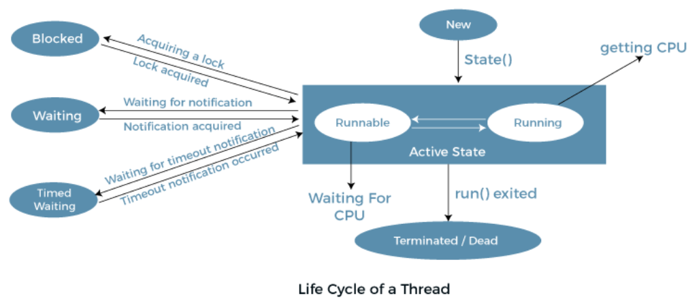
Lifecycle of a Thread

Slide 11
By extending Thread class
import java . io .∗; import java.util.∗; public class GFG extends Thread { // initiated run method for Thread public void run() { System.out.println(”Thread Started Running...”);
}
public static void main(String [] args) {
GFG g1 = new GFG(); // invoking Thread
g1. start ();}}
Output:
Thread Started Running...

Slide 12
By extending Runnable Interface
import java . io .∗; import java.util.∗; public class GFG1 implements Runnable { // method to start Thread public void run() {
System.out.println(”Thread is Running Successfully”);
public static void main(String [] args)
{
GFG1 g1 = new GFG1(); // initializing Thread Object
Thread t1= new Thread(g1); t1 . start ();}}
Output:
Thread is Running Successfully

Slide 13
Commonly used methods of Thread class:
public void run(): is used to perform action for a thread.
public void start(): starts the execution of the thread. JVM calls the run() method on the thread.
public void sleep(long miliseconds): Causes the currently executing thread to sleep (temporarily cease execution) for the specified number of milliseconds.
public void join(): waits for a thread to die.
public void join(long miliseconds): waits for a thread to die for the specified miliseconds.
public int getPriority(): returns the priority of the thread.
public int setPriority(int priority): changes the priority of the thread.

Slide 14
public String getName(): returns the name of the thread.
public void setName(String name): changes the name of the thread.
public Thread currentThread(): returns the reference of currently executing thread.
public int getId(): returns the id of the thread.
public Thread.State getState(): returns the state of the thread.
public boolean isAlive(): tests if the thread is alive.
public void yield(): causes the currently executing thread object to temporarily pause and allow other threads to execute.
public void suspend(): is used to suspend the thread.
public void resume(): is used to resume the suspended thread(depricated).
public void stop(): is used to stop the thread(depricated).

Slide 15
public boolean isDaemon(): tests if the thread is a daemon thread.
public void setDaemon(boolean b): marks the thread as daemon or user thread.
public void interrupt(): interrupts the thread.
public boolean isInterrupted(): tests if the thread has been interrupted.
public static boolean interrupted(): tests if the current thread has been interrupted.

Slide 16
Thread.sleep() method in Java
Thread Class is a class that is basically a thread of execution of the programs. It is present in Java.lang package.
Thread class contains the Sleep() method.
There are two overloaded methods of Sleep() method present in Thread Class, one is with one argument and another one is with two arguments.
The sleep() method is used to stop the execution of the current thread(whichever might be executing in the system) for a specific duration of the time and after that time duration gets over, the thread which is executing earlier starts to execute again.

Slide 17
Method Whenever Thread.sleep() functions to execute, it always pauses the current thread execution.
If any other thread interrupts when the thread is sleeping, then InterruptedException will be thrown.
If the system is busy, then the actual time the thread will sleep will be more as compared to that passed while calling the sleep method and if the system has less load, then the actual sleep time of the thread will be close to that passed while calling sleep() method.

Slide 18
Using Thread.Sleep() Method For Main Thread
import java . io .∗; import java . lang . Thread ; class GFG2 { public static void main(String [] args) {
try { for (int i=0; i<5; i++)
{
Thread . sleep (1000); System . out . println ( i );
}} catch (Exception e) { System . out . p r i n t l n ( e ) ; }}}
Output:
0 1 2 3 4

Slide 19
Using Thread.Sleep() Method For Custom ThreaD
import java . io .∗; import java . lang . Thread ; class GFG3 extends Thread {
public void run() {try { for (int i=0; i<5; i++){
Thread . sleep (1000); System . out . println ( i ); }}
catch (Exception e) { System . out . p r i n t l n ( e ) ;
}}
public static void main(String [] args) {
GFG3 obj = new GFG3();
obj . start ();
}}
Output:
0 1 2 3 4

Slide 20
IllegalArguementException When Sleep Time Is Negative
import java . io .∗; import java . lang . Thread ; class GFG5 { public static void main(String [] args)
try { for (int i=0; i<5; i++){
Thread . sleep (−100); System . out . println ( i ); }} catch (Exception e) { System . out . p r i n t l n ( e ) ; }}}
{
Output:
Error is occured

Slide 21
There are three overloaded join functions.
join(): It will put the current thread on wait until the thread on which it is called is dead. If thread is interrupted then it will throw InterruptedException.
public final void join ()
join(long millis):It will put the current thread on wait until the thread on which it is called is dead or wait for specified time (milliseconds).
public final synchronized void join(long millis)
join(long millis, int nanos): It will put the current thread on wait until the thread on which it is called is dead or wait for specified time (milliseconds + nanos).
public final synchronized void join(long millis,int nanos)

Slide 22
Joining Threads in Java
java.lang.Thread class provides the join() method which allows one thread to wait until another thread completes its execution.
If t is a Thread object whose thread is currently executing, then t.join() will make sure that t is terminated before the next instruction is executed by the program.
If there are multiple threads calling the join() methods that means overloading on join allows the programmer to specify a waiting period.
However, as with sleep, join is dependent on the OS for timing, so you should not assume that join will wait exactly as long as you specify.

Slide 23
catch(Exception ex){
System.out.println("Exception has" +" been caught" + ex);}
System.out.println(i);}}}
class GFG6
{
public static void main (String[] args)
{
ThreadJoining t1 = new ThreadJoining();
ThreadJoining t2 = new ThreadJoining();
ThreadJoining t3 = new ThreadJoining();
t1.start();
try{
import java.io.*;
class ThreadJoining extends Thread
{
public void run()
{
for (int i = 0; i < 2; i++){
try
{
Thread.sleep(1000);
System.out.println("Current Thread: "+ Thread.currentThread().getName());}

Slide 24
System.out.println("Current Thread: "+ Thread.currentThread().getName());
t1.join();}
catch(Exception ex){
System.out.println("Exception has " +"been caught" + ex);}
t2.start();
try{
System.out.println("Current Thread: "+ Thread.currentThread().getName());
t2.join();}
catch(Exception ex){
System.out.println("Exception has been" +" caught" + ex);}
t3.start();}}
Output:
Current Thread: main
Current Thread: Thread 0
Current Thread: Thread 0
Current Thread: main
Current Thread: Thread 1
Current Thread: Thread 1
Current Thread: Thread 2
Current Thread: Thread 2

Slide 25
Priority of a Thread
Each thread has a priority. Priorities are represented by a number between 1 and 10.
In most cases, the thread scheduler schedules the threads according to their priority (known as preemptive scheduling).
But it is not guaranteed because it depends on JVM specification that which scheduling it chooses.
Note that not only JVM a Java programmer can also assign the priorities of a thread explicitly in a Java program.

Slide 26
import java.lang.*;
public class ThreadPriorityExample extends Thread
{ public void run()
{
System.out.println("Inside the run() method");}
public static void main(String argvs[])
{
ThreadPriorityExample th1 = new ThreadPriorityExample();
ThreadPriorityExample th2 = new ThreadPriorityExample();
ThreadPriorityExample th3 = new ThreadPriorityExample();
System.out.println("Priority of the thread th1 is : " + th1.getPriority());
System.out.println("Priority of the thread th2 is : " + th2.getPriority());
System.out.println("Priority of the thread th3 is : " + th3.getPriority());
th1.setPriority(6);
th2.setPriority(3);
th3.setPriority(9);
System.out.println("Priority of the thread th1 is : " + th1.getPriority());
System.out.println("Priority of the thread th2 is : " + th2.getPriority());
System.out.println("Priority of the thread th3 is : " + th3.getPriority());
System.out.println("Currently Executing The Thread : " + Thread.currentThread().getName());
System.out.println("Priority of the main thread is : " + Thread.currentThread().getPriority());
Thread.currentThread().setPriority(10);
System.out.println("Priority of the main thread is : " + Thread.currentThread().getPriority());
}}
Output:
Priority of the thread th1 is : 5 Priority of the thread th2 is : 5 Priority of the thread th2 is : 5 Priority of the thread th1 is : 6 Priority of the thread th2 is : 3 Priority of the thread th3 is : 9 Currently Executing The Thread : main Priority of the main thread is : 5 Priority of the main thread is : 10

Slide 27
Synchronization in java
Multi-threaded programs may often come to a situation where multiple threads try to access the same resources and finally produce erroneous and unforeseen results.
So it needs to be made sure by some synchronization method that only one thread can access the resource at a given point in time.
Java provides a way of creating threads and synchronizing their tasks using synchronized blocks.
Synchronized blocks in Java are marked with the synchronized keyword. A synchronized block in Java is synchronized on some object.
All synchronized blocks synchronize on the same object can only have one thread executing inside them at a time.
All other threads attempting to enter the synchronized block are blocked until the thread inside the synchronized block exits the block

Slide 28
/ Only one thread can execute at a time.
// sync object is a reference to an object
// whose lock associates with the monitor.
// The code is said to be synchronized on
// the monitor object synchronized(sync object) {
// Access shared variables and other
// shared resources
}

Slide 29
This synchronization is implemented in Java with a concept called monitors. Only one thread can own a monitor at a given time.
When a thread acquires a lock, it is said to have entered the monitor.
All other threads attempting to enter the locked monitor will be suspended until the first thread exits the monitor.

Slide 30
Inter thread communication
Inter-thread communication in Java is a mechanism in which a thread is paused running in its critical section and another thread is allowed to enter (or lock) in the same critical section to be executed.
Inter-thread communication is also known as Cooperation in Java.
What is Polling, and what are the problems with it?
The process of testing a condition repeatedly till it becomes true is known as polling. Polling is usually implemented with the help of loops to check whether a particular condition is true or not. If it is true, a certain action is taken. This wastes many CPU cycles and makes the implementation inefficient.

Slide 31
How Java multi-threading tackles this problem?
To avoid polling, Java uses three methods, namely, wait(), notify(), and notifyAll(). All these methods belong to object class as final so that all classes have them. They must be used within a synchronized block only.
wait(): It tells the calling thread to give up the lock and go to sleep until some other thread enters the same monitor and calls notify().
notify(): It wakes up one single thread called wait() on the same object. It should be noted that calling notify() does not give up a lock on a resource.
notifyAll(): It wakes up all the threads called wait() on the same object.

Slide 32
class Customer{
int amount=10000;
synchronized void withdraw(int amount){
System.out.println("going to withdraw...");
if(this.amount<amount){
System.out.println("Less balance; waiting for deposit...");
try{wait();}catch(Exception e){}
}
this.amount-=amount;
System.out.println("withdraw completed...");
}
synchronized void deposit(int amount){
System.out.println("going to deposit...");
this.amount+=amount;
System.out.println("deposit completed... ");
notify();
}
}
class Test{
public static void main(String args[]){
final Customer c=new Customer();
new Thread(){
public void run(){c.withdraw(15000);}
}.start();
new Thread(){
public void run(){c.deposit(10000);}
}.start();
}}
Output:
going to withdraw...
Less balance;
waiting for deposit...
going to deposit...
deposit completed...
withdraw completed

Slide 33
https://www.youtube.com/watch?v=Ut8YFsi2WR0

Slide 34
Object Oriented Programming (OOP) Course Code: CSE2005/SWE2005
MODULE – 6
(Introducing to JavaFX)
By:
Dr. Nagendra Panini Challa
Assistant Professor, Senior Grade 2
SCOPE, VIT-AP University, India

Slide 35
Agenda
JavaFX Basic Concepts
Event Basics
Drawing directly on Canvas
JavaFX Controls
Button
Checkbox
Label
List View
Radio Button
Scroll Pane
Text Field
Toggle Button
Tree View
Menu Basics

Slide 36
Introduction
JavaFX is a Java library and a GUI toolkit designed to develop and facilitate Rich Internet applications, web applications, and desktop applications.
The most significant perk of using JavaFX is that the applications written using this library can run on multiple operating systems like Windows, Linux, iOS, Android, and several platforms like Desktops, Web, Mobile Phones, TVs, Tablets, etc.
This characteristic of the JavaFX library makes it very versatile across operating systems and different platforms.

Slide 37
Need of JavaFX
Before JavaFX, developing the client base applications was a very complicated and cumbersome task.
Programmers and developers used to require several libraries for adding various functionalities like media, UI controls, animations and effects, 2D and 3D shapes, etc., in their applications.
This issue was resolved when JavaFX came into the picture, which changed the whole scenario of the development of web applications by bringing in all the peculiarities into one single library.
Apart from this, the programmers can also utilize all the existing perks of the older libraries like Java Swing and Advanced Windowing Tool Kit.

Slide 38
Features:
JavaFX is an open-source framework based on Java, used for advancing rich client applications. The JavaFX library comprises numerous peculiarities that make it a handpicked option for developers to develop rich client applications. These features are as follows:
Java Library – JavaFX is a Java library, which allows the user to gain the support of all the Java characteristics such as multithreading, generics, lambda expressions, and many more.
Platform Independent – The rich internet applications made using JavaFX are platform-independent. The JavaFX library is open for all the scripting languages that can be administered on a JVM, which comprise – Java, Groovy, Scala, and JRuby.

Slide 39
FXML – JavaFX emphasizes an HTML-like declarative markup language known as FXML. FXML is based on extensible markup language (XML).
Scene Builder – JavaFX also implements a tool named Scene Builder, which is a visual editor for FXML. Scene Builder generates FXML mark-ups that can be transmitted to the IDE’s like Eclipse and NetBeans, which further helps the user to combine the business logic to their applications.
Hardware-accelerated Graphics Pipeline – The graphics of the JavaFX applications are based on the hardware-accelerated graphics rendering pipeline, commonly known as Prism.
Built-in UI controls – JavaFX comprises all the major built-in UI controls that help in developing well-featured applications. These built-in UI components are not operating system-dependent.

Slide 40
Here is a list of some of general use cases I see for JavaFX:
Developer tools
IDE
Editors
File compression / encryption tools
Tools scanning the local disk
Local system maintenance tools
Backup tools
Virus scans
Utility apps
Skype / Messenger / Chat
Screen shot tools
Photo and video editing
Video players
Audio editing
Audio players
Games
Data Science Tools
Here are some of the desktop apps I use regularly:
IntelliJ IDEA
Notepad++
SourceTree
SnagIt
Putty
WinSCP
Skype
Signal
Telegram
PhotoShop
Premiere Pro
VideoLAN (VLC)
EDraw
Additionally, several companies that have started with web applications have later added native / local desktop applications. Some of these are:
YouTube Music
Spotify
Microsoft Teams
Slack
Google Drive

Slide 41
Java Event Basics
The events can be broadly classified into the following two categories −
Foreground Events − Those events which require the direct interaction of a user. They are generated as consequences of a person interacting with the graphical components in a Graphical User Interface. For example, clicking on a button, moving the mouse, entering a character through keyboard, selecting an item from list, scrolling the page, etc.
Background Events − Those events that don't require the interaction of end-user are known as background events. The operating system interruptions, hardware or software failure, timer expiry, operation completion are the example of background events.

Slide 42
Events in JavaFX
JavaFX provides support to handle a wide varieties of events. The class named Event of the package javafx.event is the base class for an event.
An instance of any of its subclass is an event. JavaFX provides a wide variety of events. Some of them are are listed below.
Mouse Event − This is an input event that occurs when a mouse is clicked. It is represented by the class named MouseEvent. It includes actions like mouse clicked, mouse pressed, mouse released, mouse moved, mouse entered target, mouse exited target, etc.
Key Event − This is an input event that indicates the key stroke occurred on a node. It is represented by the class named KeyEvent. This event includes actions like key pressed, key released and key typed.
Drag Event − This is an input event which occurs when the mouse is dragged. It is represented by the class named DragEvent. It includes actions like drag entered, drag dropped, drag entered target, drag exited target, drag over, etc.
Window Event − This is an event related to window showing/hiding actions. It is represented by the class named WindowEvent. It includes actions like window hiding, window shown, window hidden, window showing, etc.

Slide 43
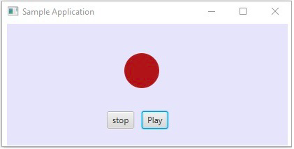
Event Handling
Event Handling is the mechanism that controls the event and decides what should happen, if an event occurs. This mechanism has the code which is known as an event handler that is executed when an event occurs. JavaFX provides handlers and filters to handle events. In JavaFX every event has −
Target − The node on which an event occurred. A target can be a window, scene, and a node.
Source − The source from which the event is generated will be the source of the event. In the above scenario, mouse is the source of the event.
Type − Type of the occurred event; in case of mouse event – mouse pressed, mouse released are the type of events.

Slide 44
For sample program on event handler
https://www.tutorialspoint.com/javafx/javafx_event_handling.htm
https://www.javatpoint.com/javafx-event-handlers

Slide 45
Drawing directly on canvas
Canvas class is a part of JavaFX.
Canvas class basically creates an image that can be drawn on using a set of graphics commands provided by a Graphics Context.
Canvas has a specified height and width and all the drawing operations are clipped to the bounds of the canvas.
Constructors of the class:
Canvas(): Creates a new canvas object.
Canvas(double w, double h): Creates a new canvas object with specified width and height.

Slide 46
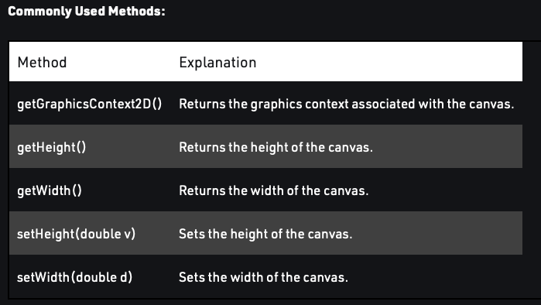

Slide 47
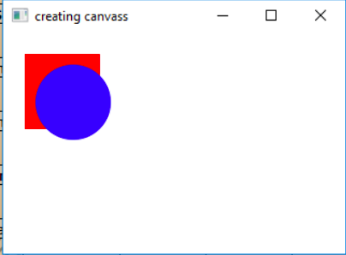
// graphics context
GraphicsContext graphics_context =
canvas.getGraphicsContext2D();
// set fill for rectangle
graphics_context.setFill(Color.RED);
graphics_context.fillRect(20, 20, 70, 70);
// set fill for oval
graphics_context.setFill(Color.BLUE);
graphics_context.fillOval(30, 30, 70, 70);
// create a Group
Group group = new Group(canvas);
// create a scene
Scene scene = new Scene(group, 200, 200);
// set the scene
stage.setScene(scene);
stage.show();
}
// Main Method
public static void main(String args[])
{
// launch the application
launch(args);
}
}
// Java Program to create a canvas with specified
// width and height(as arguments of constructor),
// add it to the stage and also add a circle and
// rectangle on it
import javafx.application.Application;
import javafx.scene.Scene;
import javafx.scene.control.*;
import javafx.scene.layout.*;
import javafx.stage.Stage;
import javafx.event.ActionEvent;
import javafx.event.EventHandler;
import javafx.scene.canvas.*;
import javafx.scene.paint.Color;
import javafx.scene.Group;
public class canvas extends Application {
// launch the application
public void start(Stage stage)
{
// set title for the stage
stage.setTitle("creating canvas");
// create a canvas
Canvas canvas = new Canvas(100.0f, 100.0f);

Slide 48
Treeview
A tree provides a view of hierarchical structures, each tree contains a root (highest object) and it contains children. You can create a tree view by instantiating the javafx.scene.control.TreeView class.
Example program:
https://www.tutorialspoint.com/how-to-create-a-treeview-using-javafx

Slide 49
MENU BASICS
Menu is a popup menu that contains several menu items that are displayed when the user clicks a menu. The user can select a menu item after which the menu goes into a hidden state.
MenuBar is usually placed at the top of the screen which contains several menus. JavaFX MenuBar is typically an implementation of a menu bar.
Constructor of the MenuBar class are:
MenuBar(): creates a new empty menubar.
MenuBar(Menu… m): creates a new menubar with the given set of menu.
Constructor of the Menu class are:
Menu(): creates an empty menu
Menu(String s): creates a menu with a string as its label
Menu(String s, Node n):Constructs a Menu and sets the display text with the specified text and sets the graphic Node to the given node.
Menu(String s, Node n, MenuItem… i):Constructs a Menu and sets the display text with the specified text, the graphic Node to the given node, and inserts the given items into the items list.

Slide 50
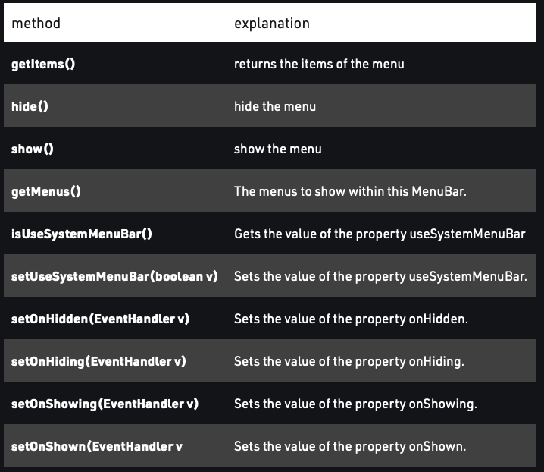
https://www.geeksforgeeks.org/javafx-menubar-and-menu/

